Slide 1

DEVELOPING A SECURE CLOUD STORAGE SYSTEM WITH MULTI-FACTOR AUTHENTICATION FOR ZAMBIAN MICRO-FINANCE INSTITUTIONS
BY
CHIPYOKA MWAPE

Slide 2
BACKGROUND AND INTRODUCTION
In recent years, Zambia has made significant progress in digital transformation, with national strategies emphasizing cloud adoption and secure digital services, finance and banking sectors inclusive.
Nevertheless, the increasing reliance on cloud computing for data storage has heightened concerns around data confidentiality, integrity, and regulatory compliance, particularly within financial institutions.
For Micro-Finance Institutions in Zambia, integrating AES-256 encryption with MFA is critical to securing sensitive financial data, ensuring regulatory compliance, and building resilient cloud infrastructures aligned with global security best practices.

Slide 3
PROBLEM STATEMENT
Many MFIs continue to operate on traditional physical data storage methods, such as hard copy documents, local hard drives that do not extend to cloud solutions. This dependency on traditional physical storage not only limits operational efficiency, scalability, and data accessibility but also exposes these institutions to heightened risks of data loss and cyber threats. Furthermore, existing cloud solutions are not tailored to the unique regulatory, infrastructural, and operational challenges of the Zambian microfinance sector.

Slide 4
RESEARCH OBJECTIVES
To develop a Secure Cloud Storage System for Zambian Micro-Finance Institutions.
To implement Multi-Factor Authentication (MFA) in a cloud storage system.
To integrate AES-256 and RSA advanced file encryption that protects data from breaches.

Slide 5
RESEARCH QUESTIONS
How can a scalable and secure cloud storage system be designed ensuring compliance with the needs of Zambian Micro-Finance Institutions?
How can Multi-Factor Authentication (MFA) be implemented in a cloud storage system for Zambian Micro-Finance Institutions?
How can AES-256 and RSA advanced file encryption protect data from breaches?

Slide 6
SCOPE OF RESEARCH
This project focused on the design and development of a Secure Cloud Storage System tailored for Zambian Micro-Finance Institutions (MFIs):
A scalable secure cloud-based storage platform.
Multi-Factor Authentication (MFA) Implementation.
Advanced Data Encryption.
Data Backup and Recovery Mechanism.
A RESTful API for Enterprise Resource Planning (ERP) integration

Slide 7
SIGNIFICANCE OF STUDY
The study addresses a critical gap in Zambia's microfinance sector by transitioning institutions from less secure, traditional data storage methods to a secure, cloud-based solution, reducing operational inefficiencies and cyber risks.
By integrating advanced security measures the project enhances data protection, scalability, and regulatory compliance, aligning with Zambia’s Data Protection Act of 2021.

Slide 8
Literature Review
Authors | Title | Research Focus
Devanath et al. (2025) | Multi Factor Authentication in the Cloud Bridging the Gap Between Security and User Experience | This study evaluates the effectiveness of Multi-Factor Authentication (MFA) in securing cloud platforms while preserving usability. The authors find that layered authentication reduces breach risks and recommend flexible, context-aware MFA implementations.
Okoye et al. (2024) | Securing financial data storage: A review of cybersecurity challenges and solutions. | The paper aims to analyze cybersecurity challenges in African financial data storage, evaluate the effectiveness of current protective measures, and explore how emerging technologies.
Patel et al. (2023) | The impact of cloud computing in the field of finance: A comprehensive analysis. | This research evaluates cloud computing’s impact on finance, weighing its advantages against security and compliance challenges, and advocating for strategic adoption.
Müller, F., & Schmidt, H. (2020). | Advanced encryption standards in European cloud storage systems. | This research focuses on the application of AES-256 encryption in European cloud storage systems, discussing regulatory compliance and effective security measures.

Slide 9
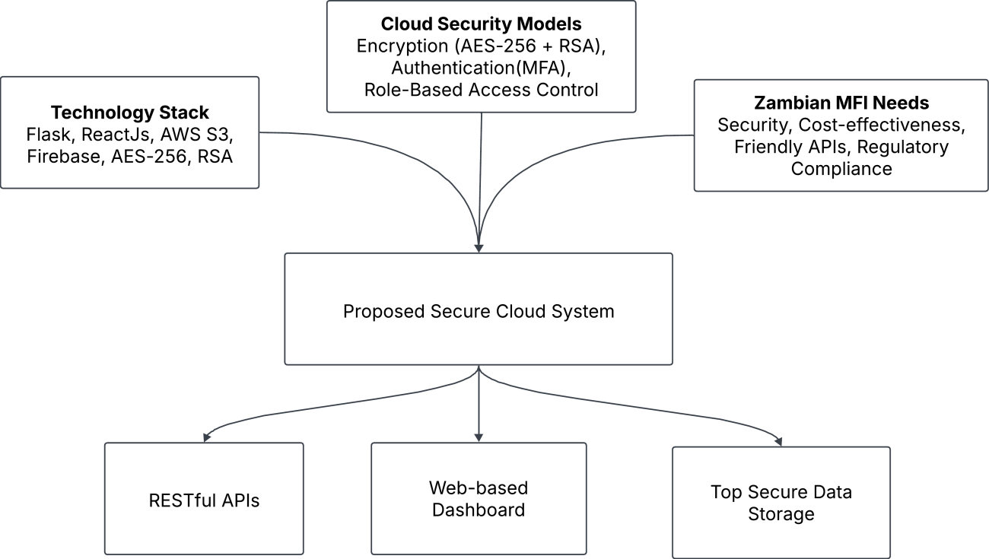
CONCEPTUAL FRAMEWORK

Slide 10
METHODOLOGY - RESEARCH
SOFTWARE DEVELOPMENT METHODOLOGY:
- Hybrid:
  CRISP-DM and
  Agile (Scrum) methodologies
REQUIREMENTS GATHERING TECHNIQUES:
  Document Review, Questionnaires, Interviews

Slide 11
METHODOLOGY - SOFTWARE
Requirements Specification | Functional Requirements: User Management, Data Storage and Retrieval, Role-based Access Control, Logging and Auditing, Intuitive User Interface Non Functional Requirements: Performance, Security, Scalability, Usability, Reliability and Availability, Compliance, Data Backup and Recovery
Software Design Specification | UML Tools: Use-case diagrams, Activity Diagrams, Sequence Diagrams, Component Diagrams, Class Diagrams.
Software Development and Testing Tools | Visual Studio Code, Postman, PgAdmin4 (PostgreSQL), Git, GitHub, Python, Javascript, Amazon Web Services (AWS).

Slide 12
FINDINGS (DATA PRESENTATION, ANALYSIS & DISCUSSION
Specific Objective | Result Achieved | Discussion
1. Develop a Secure Cloud Storage System for Zambian MFIs | The system was fully implemented using Flask, PostgreSQL, AWS S3, and client-side React, delivering fast file uploads/downloads. The architecture supports concurrent users and operates efficiently on low-resource devices due to its lightweight design. | Results strongly support established international standards while contextualizing them to Zambia’s operational environment. The practical implications of these findings are significant for micro-finance institutions operating within Zambia’s resource-constrained technology landscape The system advances the field by providing a working model that aligns global encryption standards with local constraints
2. Implement Multi-Factor Authentication (MFA) | Firebase Email OTP was successfully integrated, with OTP delivery occurring within seconds. The system enforces MFA during login, significantly enhancing security.
3. Integrate AES-256 and RSA for Advanced Encryption | All files in transit and stored on AWS S3 are encrypted using hybrid AES-256 + RSA. File integrity is preserved through SHA-256 checksums, and key management mechanisms are supported.

Slide 13
CONCLUSION
This project aimed at designing and developing a secure, scalable cloud storage system tailored to the operational and security needs of Zambian MFI, focusing on integrating MFA and advanced file data encryption.
The project: Demonstrates that a secure cloud storage system incorporating MFA and advanced encryption can be successfully designed and implemented for Zambian Micro-Finance Institutions.
The study: advances both practical application and academic understanding of secure cloud adoption in developing financial sectors, thereby fulfilling the stated research objectives and providing a solid foundation for future enhancements.

Slide 14
RECOMMENDATIONS
Further research could also explore the integration of advanced AI threat detection mechanisms
Adopt the secure cloud storage architecture as part of digital transformation strategy.
Implement tiered access controls and clear data governance policies.
Train staff on secure data handling and MFA usage.
Align technology adoption with policy support to enhance security and financial inclusion.

